Slide 1
Below are a number of professionally designed social media tiles with editable text to promote your conference in Wellington.
How to use these slides
choose a slide
insert your event details
select the slide and “save as” in “jpeg” format. Choose “Just this slide” when prompted)
For questions about these assets or for assistance promoting your conference in Wellington, contact BusinessEvents@WellingtonNZ.com

Slide 2
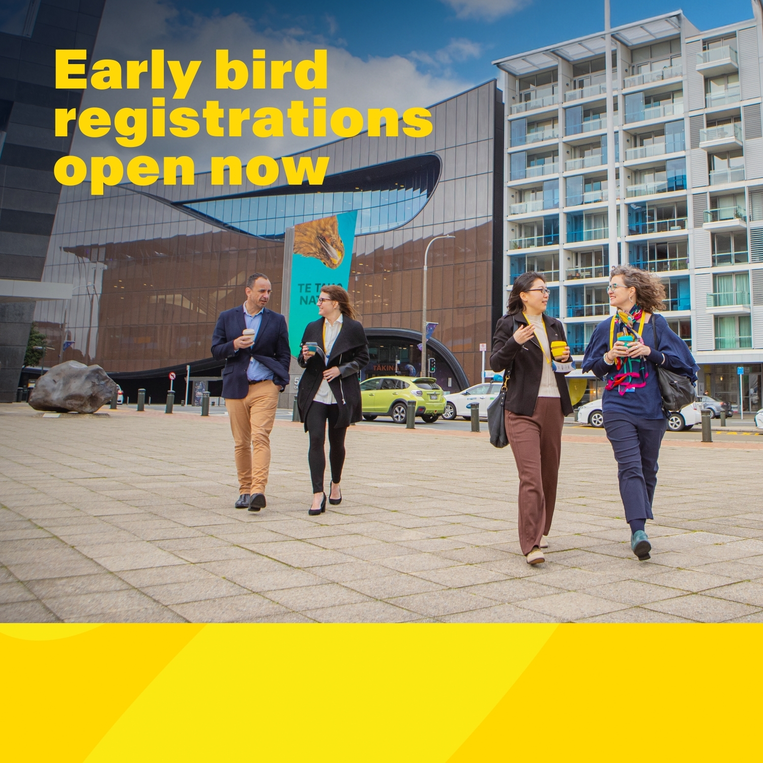
LOGO HERE (OPTIONAL)
Event name here
Event date or website here

Slide 3
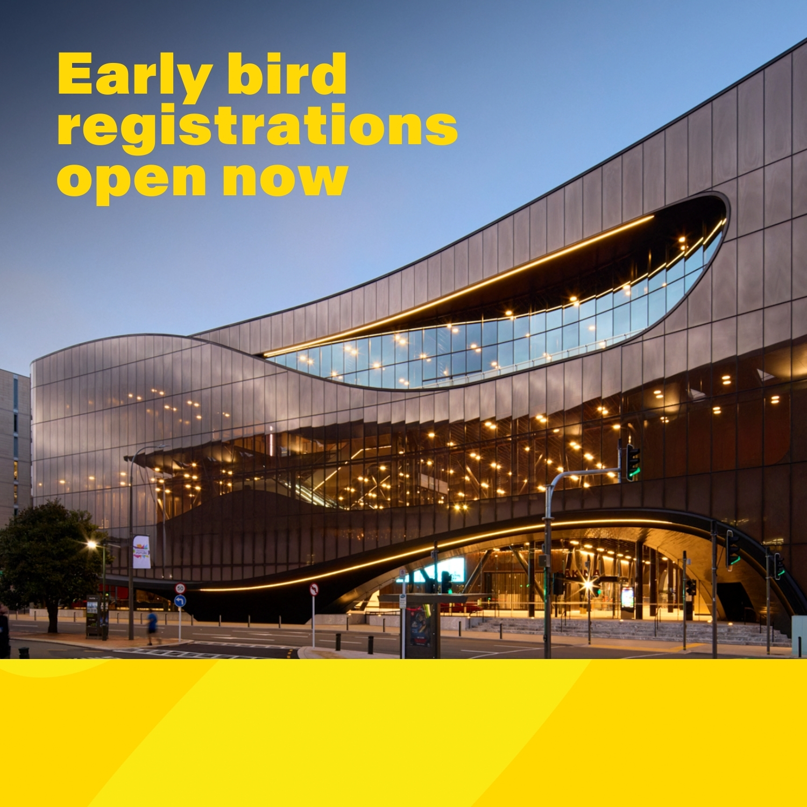
LOGO HERE (OPTIONAL)
Event name here
Event date or website here

Slide 4
LOGO HERE (OPTIONAL)
Event name here
Event date or website here

Slide 5
LOGO HERE (OPTIONAL)
Event name here
Event date or website here

Slide 6
LOGO HERE (OPTIONAL)
Event name here
Event date or website here

Slide 7
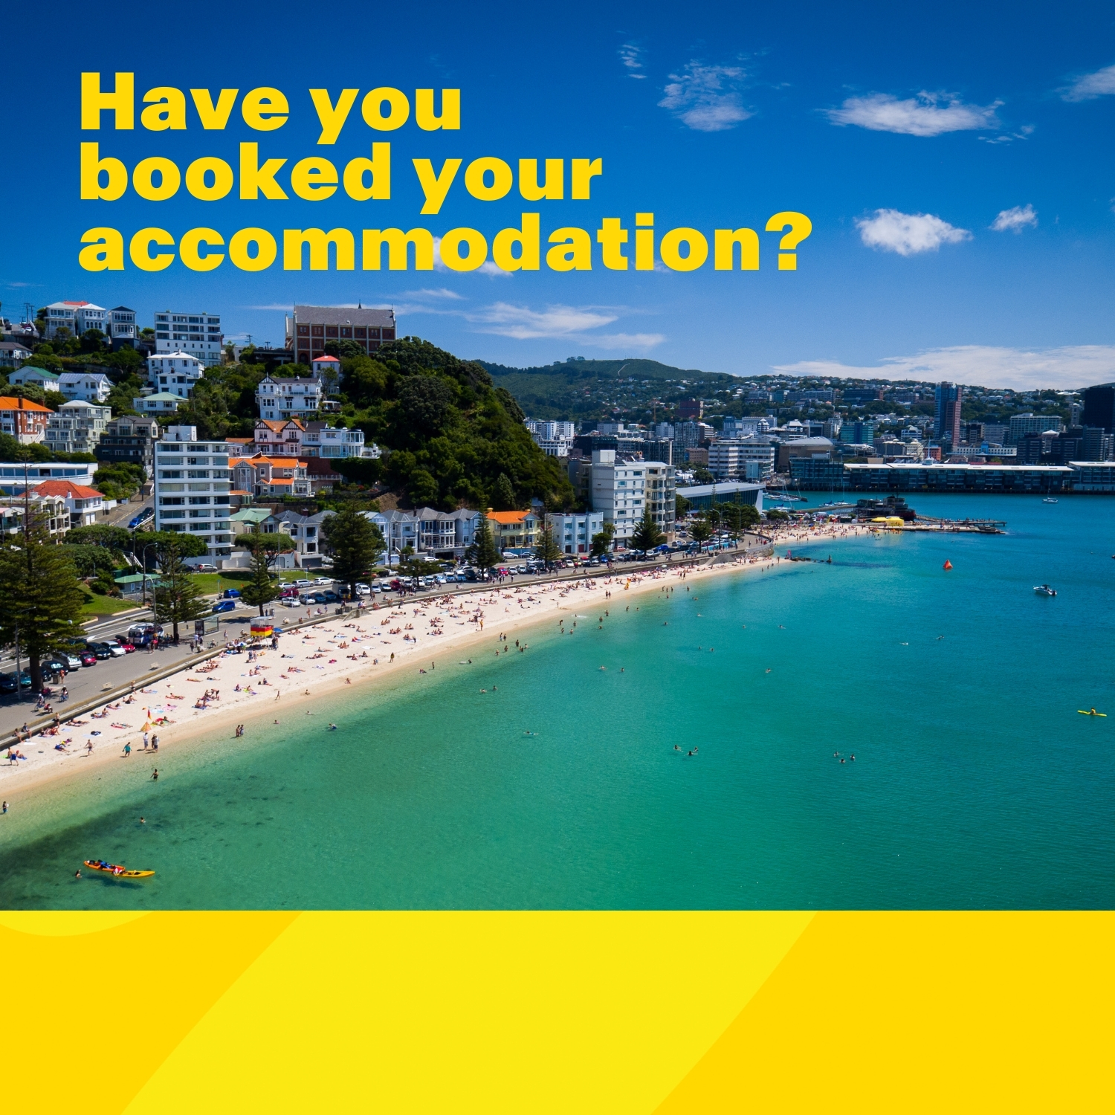
LOGO HERE (OPTIONAL)
Event name here
Event date or website here

Slide 8
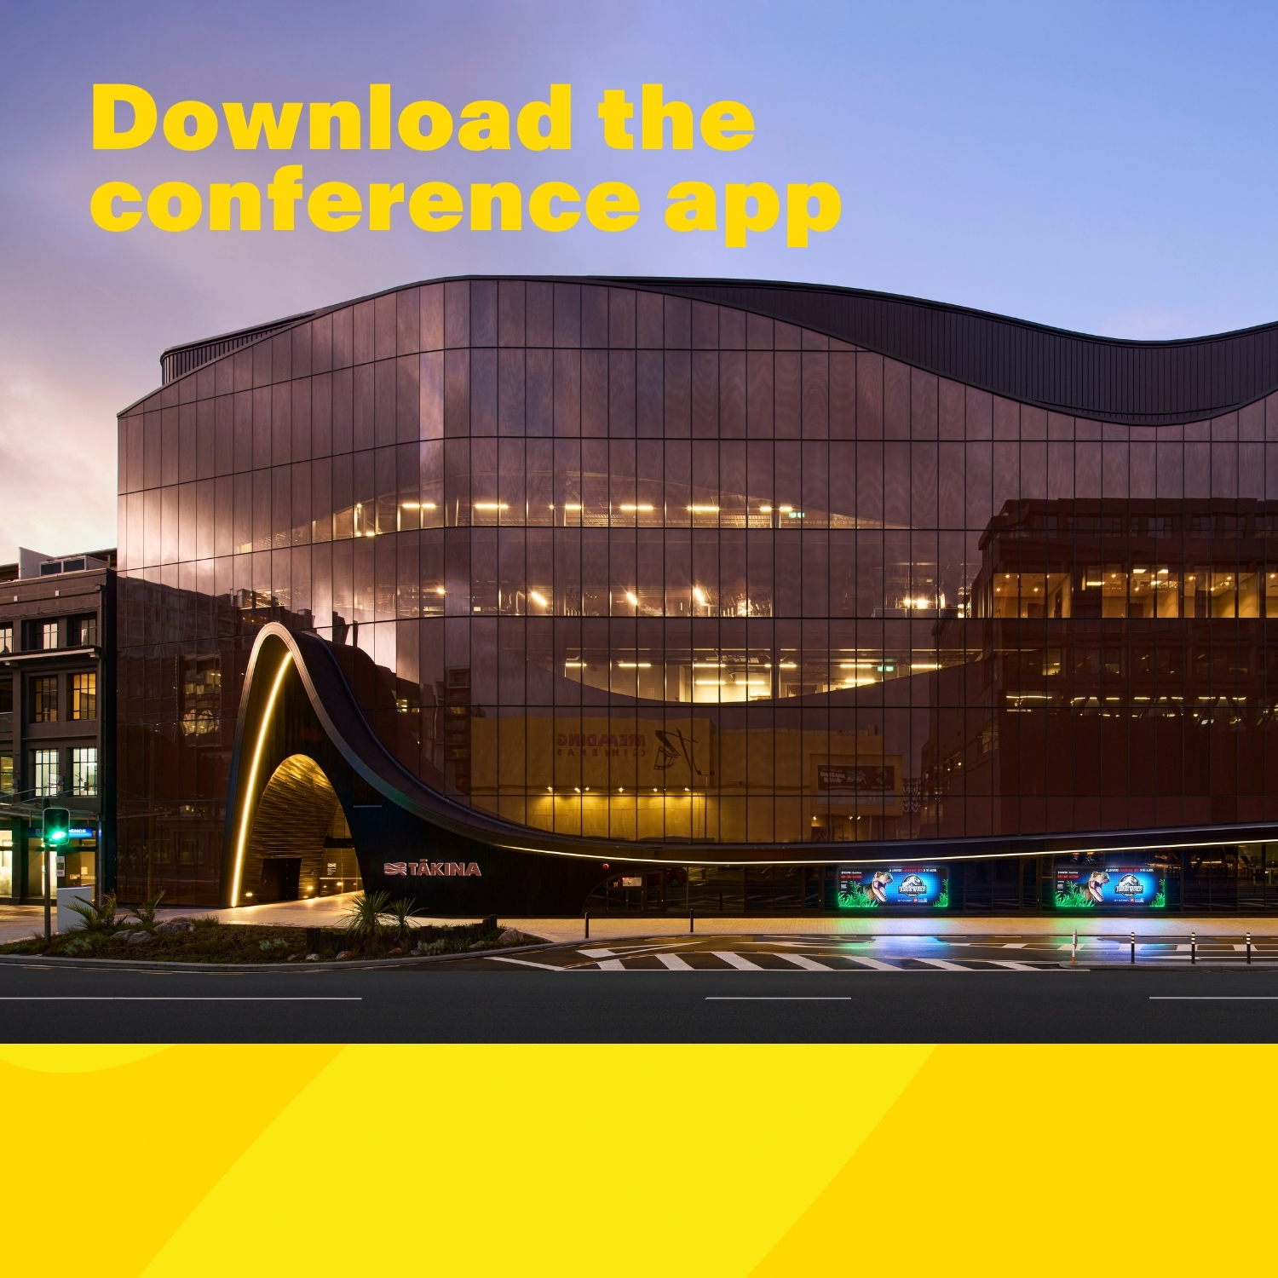
LOGO HERE (OPTIONAL)
Event name here
Event date or website here

Slide 9
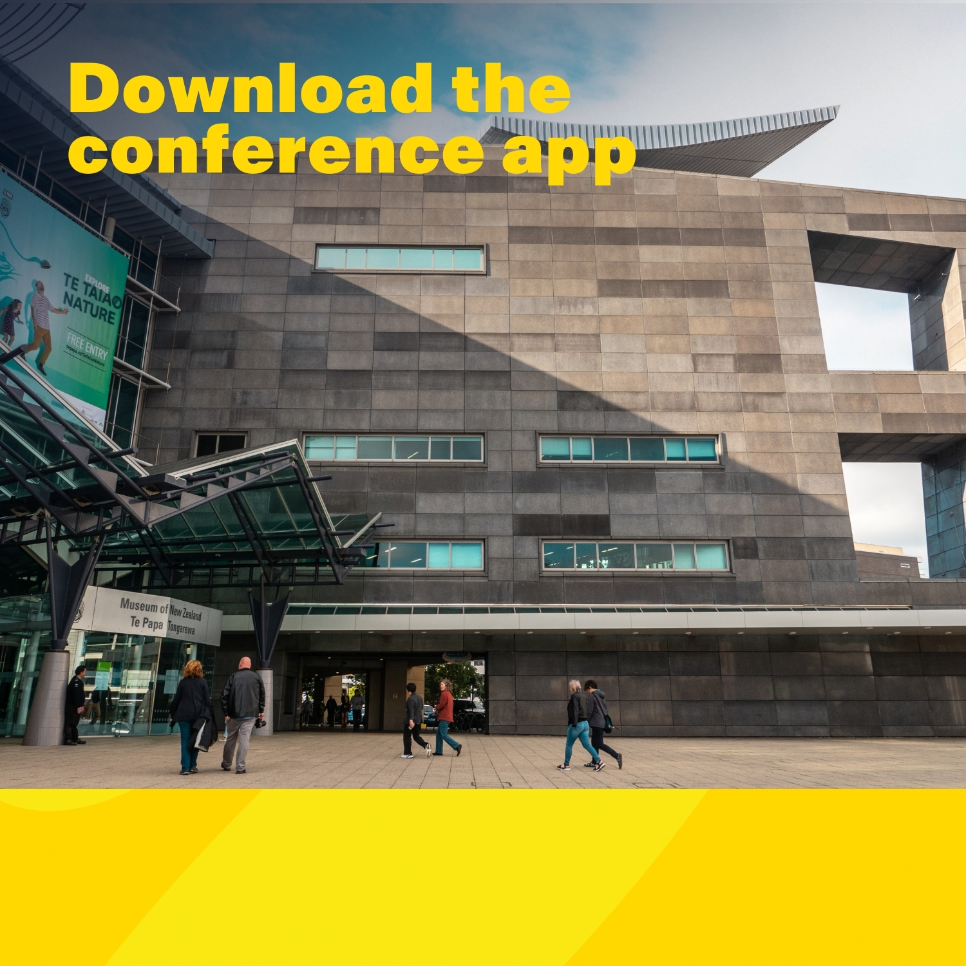
LOGO HERE (OPTIONAL)
Event name here
Event date or website here

Slide 10
LOGO HERE (OPTIONAL)
Event name here
Event date or website here

Slide 11
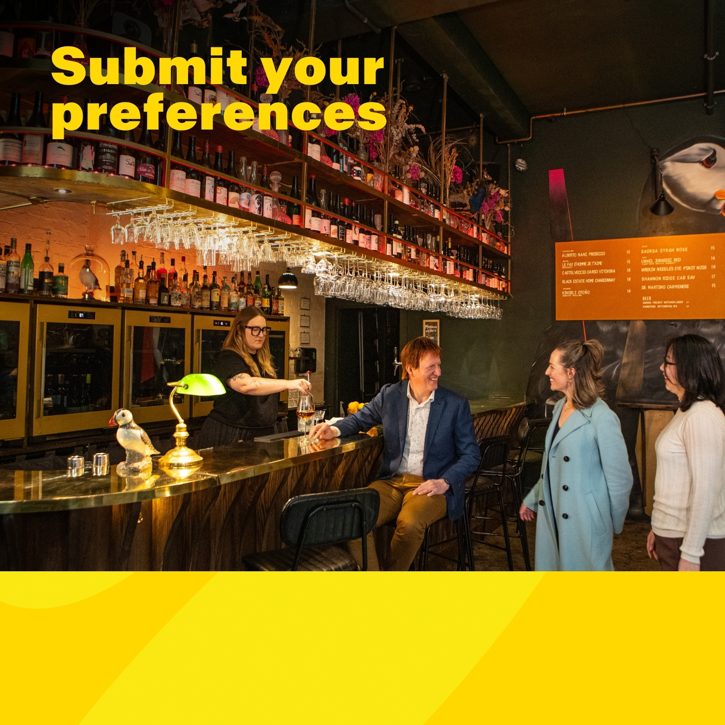
LOGO HERE (OPTIONAL)
Event name here
Event date or website here

Slide 12
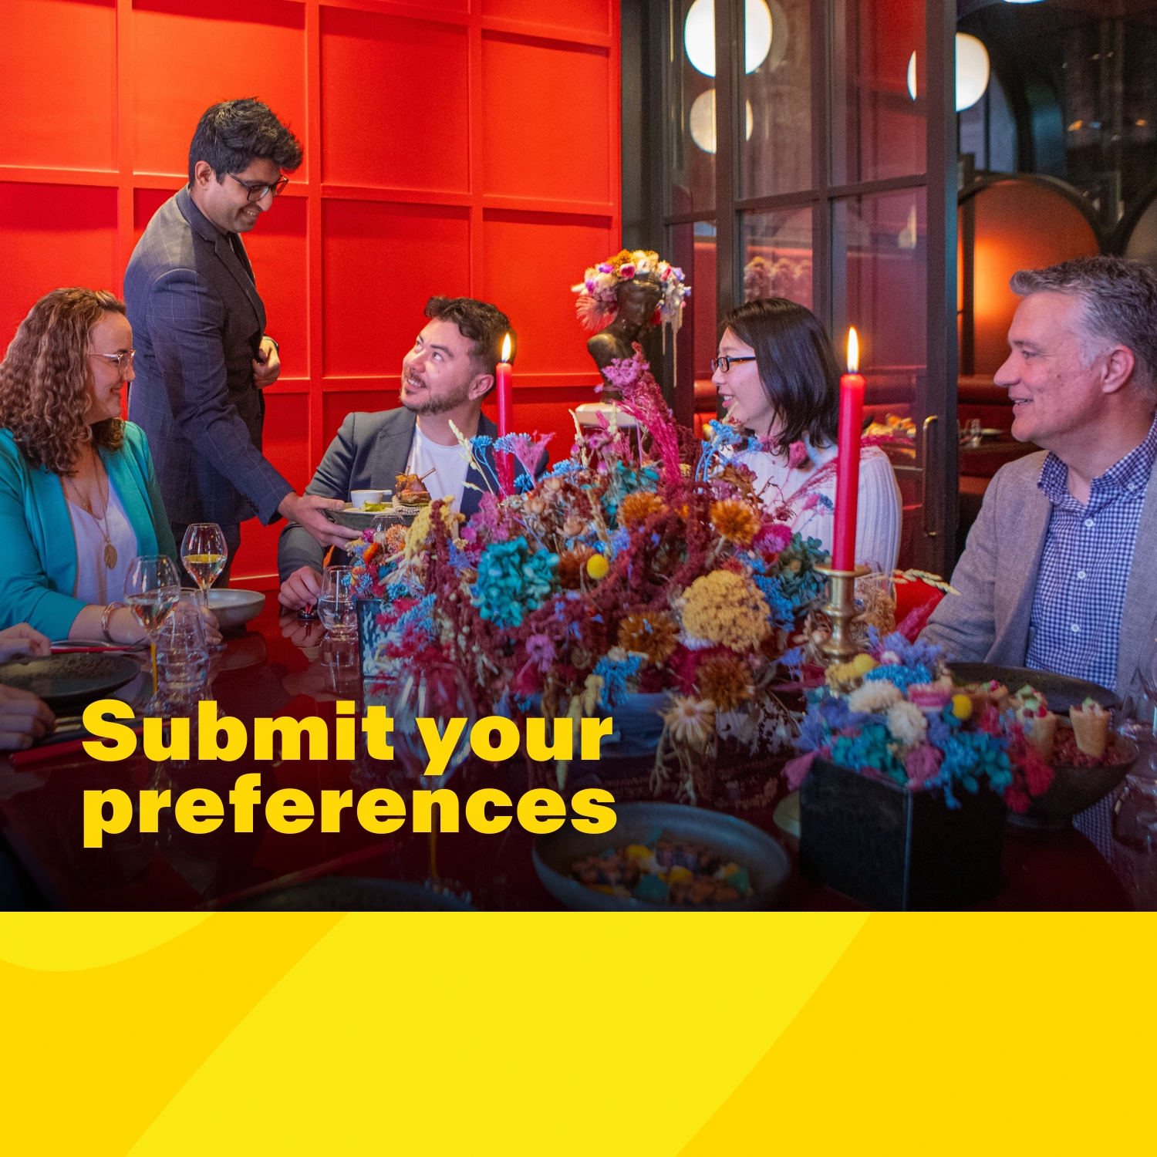
LOGO HERE (OPTIONAL)
Event name here
Event date or website here

Slide 13
LOGO HERE (OPTIONAL)
Event name here
Event date or website here

Slide 14
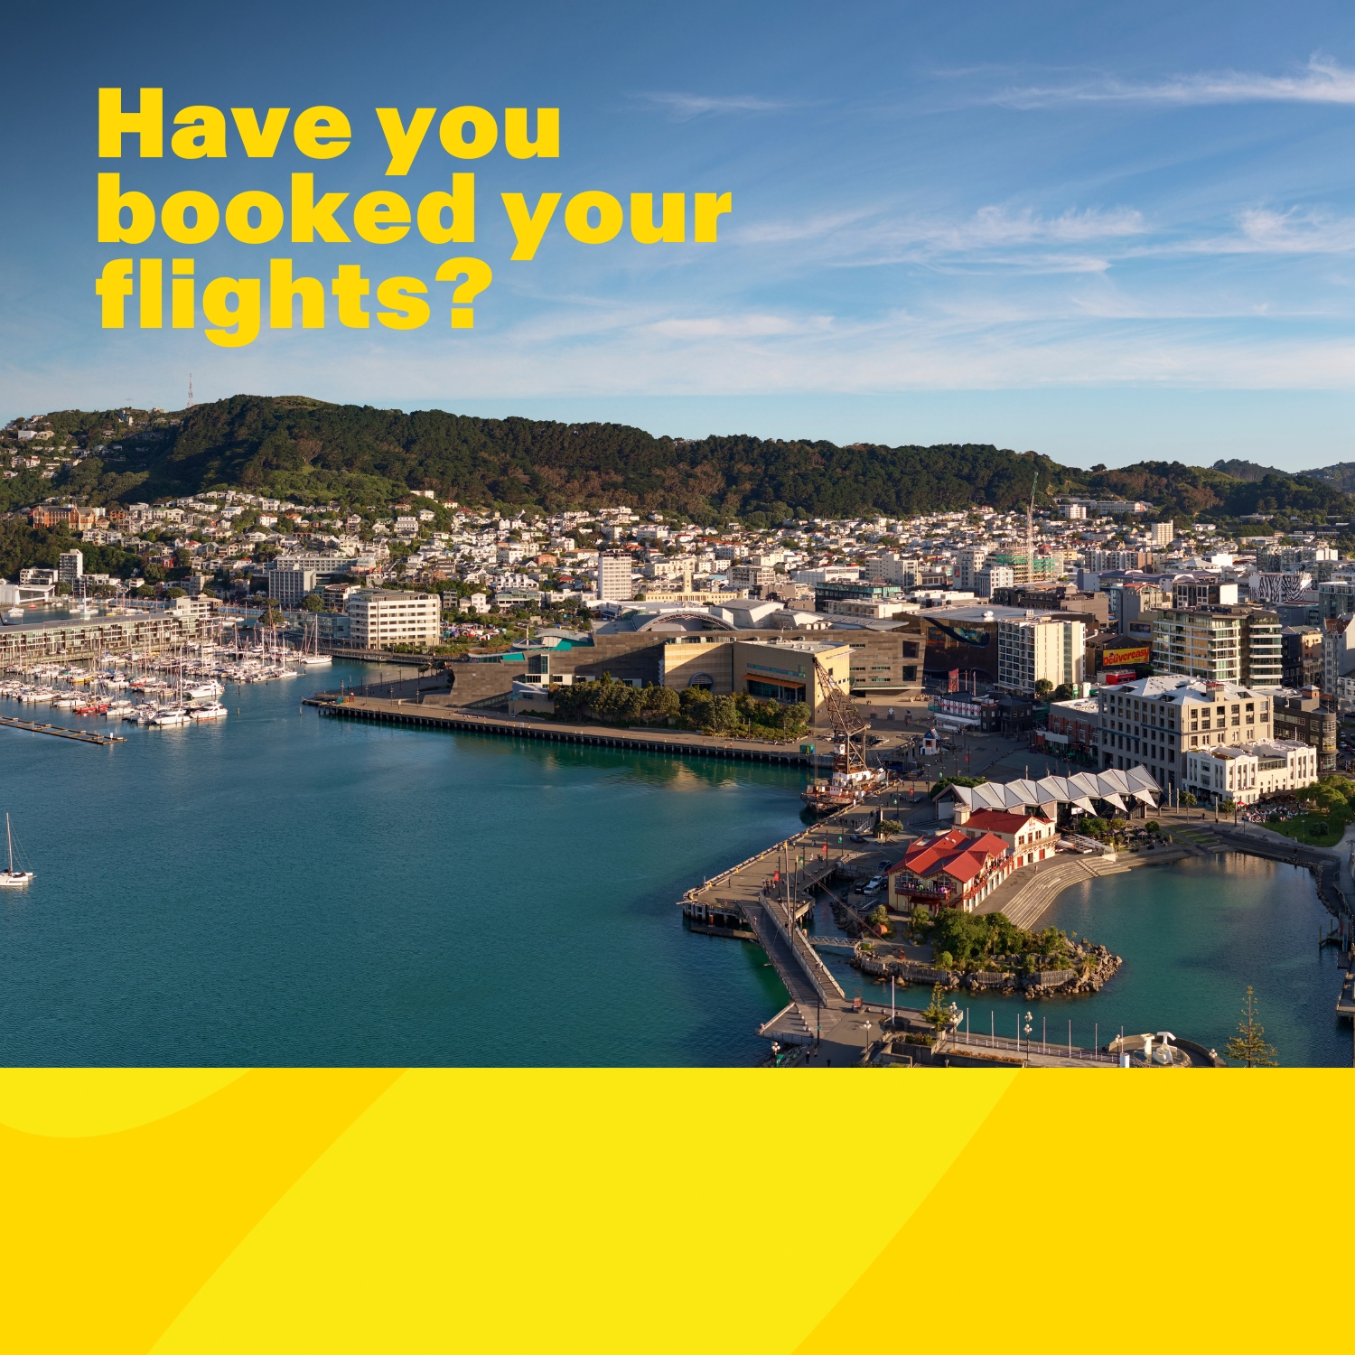
LOGO HERE (OPTIONAL)
Event name here
Event date or website here

